Slide 1
BITS Pilani presentation
Yogesh B
Introduction to DevOps

Slide 2
CSIZG514/SEZG514, Introduction to DevOps
Lecture No. 5

Slide 3
Agenda
Git
Git basic commands

Slide 4

Git basic commands
Getting a Git Repository or Creating a Git Repository
You typically obtain a Git repository in one of two ways
  You can take a local directory that is currently not under version control, and turn it into a Git repository
  OR
  You can clone an existing Git repository from elsewhere
Initializing a Repository in an Existing Directory
  Go to the Project Directory which is not under version control
  And type
#git init

Slide 5
Git basic commands
Cloning an Existing Repository
If you want to get a copy of an existing Git repository
You should notice that the command is "clone" and not "checkout“
Instead of getting just a working copy, Git receives a full copy of nearly all data that the server has
Every version of every file for the history of the project is pulled down by default when you run git clone
Benefit: if your server disk gets corrupted, you can often use nearly any of the clones on any client to set the server back to the state it was in when it was cloned
#git clone <url>

Slide 6
Git basic commands
Create a working copy
Create a working copy of a local repository
When using a remote server:
#git clone /path_to_repository
#git clone username@host:/path_to_repository

Slide 7
Git basic commands
Getting a Git Repository Status:
The Git command to know exactly what you changed, not just which files were changed
git diff shows you the exact lines added and removed — the patch, as it were
That command compares what is in your working directory with what is in your staging area
#git diff

Slide 8
Git basic commands
Add a file to Git Repository
The Git command to add a file to the git repository is git add
This command updates the index using the current content found in the working tree, to prepare the content staged for the next commit
Before using commit command you must use the add any new or modified files to the index
#git add <file name>

Slide 9
Git basic commands
Committing your changes
Once the staging area is set up, you can commit your changes
Remember that anything that is still unstaged i.e. any files you have created or modified that you haven’t run git add on since you edited them, those won’t go into this commit
The default commit message contains the latest output of the git status
#git commit
#git commit –m “Commit Message”

Slide 10
Git basic commands
Removing Files from a Git Repository
To remove a file from Git, you have to remove it from your staging area and then commit
The git rm command does that
#git rm <filename>

Slide 11
Git basic commands
Moving Files or Renaming Files in a Git Repository
Unlike many other VCS systems, Git doesn’t explicitly track file movement
If you rename a file in Git, no metadata is stored in Git that tells it you renamed the file
To rename a file in Git, you can run
#git mv <file_from> <file_to>

Slide 12
Git basic commands
Viewing the Commit History of Git Repository
After you have created several commits, or if you have cloned a repository with an existing commit history, you’ll probably want to look back to see what has happened
The most basic and powerful tool to do this is the
By default, with no arguments, git log lists the commits made in that repository in reverse chronological order i.e. the most recent commits show up first
To see only the commits of a certain author
#git log
#git log --author=john

Slide 13
Git basic commands
Git Branching
As we saw nearly every Version Control System has Branching Support
Branching means you diverge from the main line of development and continue to do work without messing with that main line
Branches are used to develop features isolated from each other
The way Git branches is incredibly lightweight, making branching operations nearly instantaneous
Git doesn’t store data as a series of changesets or differences
However Git instead stores data as a series of snapshots
Which means when you make a commit, Git stores a commit object that contains a pointer to the snapshot of the content you staged

Slide 14
Git basic commands
Git Branching Contd..
X - Development
Branch
Merge
Master
#git branch <branch name>

Slide 15
Git basic commands
Git Branching Contd..
What happens if you create a new branch?
Creation of Branch creates a new pointer for you to move around
How does Git know what branch you’re currently on?
Git keeps a special pointer called HEAD; HEAD acts as a pointer to the local branch you’re currently on
The git branch command only created a new branch; it didn’t switch to that branch, you will be still on master branch
To switch to an existing branch, you run
#git checkout <branch name>

Slide 16
Git basic commands
Git Merging
When to Merge?
If you have completed the hotfix development or feature development or the Individual task branched, and up on completion of that now you need to add that component to the Master
How does it work?
First you need to checkout the branch you wish to merge in to, for an example here we will be merging in Master Branch
Then Run
#git merge <name of branch>

Slide 17
Git basic commands
Getting a Git Repository Status & check conflicts
The main tool you use to determine which files are in which state is the git status command
The below output means you have a clean working directory — in other words, none of your tracked files are modified
#git status
Example:
$ git status
On branch master
No commits yet
Changes to be committed:
(use "git rm --cached <file>..." to unstage)

Slide 18
Git basic commands
Git check conflicts or status
git status output is pretty comprehensive, it’s quite self explanatory
Lets see how the conflicts output looks like
$ git status
On branch master
You have unmerged path
(Fix conflict and run “git-commit”)

Slide 19
Git basic commands
Git Revert
The git revert command can be considered an 'undo' type command
however, it is not a traditional undo operation
Instead of removing the commit from the project history, it figures out how to invert the changes introduced by the commit and appends a new commit with the resulting inverse content
This prevents Git from losing history, which is important for the integrity of your revision history and for reliable collaboration
Reverting should be used when you want to apply the inverse of a commit from your project history
Git revert expects a commit ref is passed in and will not execute without one

Slide 20
Git basic commands
Git Revert:
Similar to a merge, a revert will create a new commit
It's important to understand that git revert undoes a single commit
It does not "revert" back to the previous state of a project by removing all subsequent commits
The git revert command is a forward-moving undo operation that offers a safe method of undoing changes
Instead of deleting or orphaning commits in the commit history, a revert will create a new commit that inverses the changes specified
Git revert is a safer alternative to git reset in regards to losing work
#git revert HEAD

Slide 21
Git basic commands
Git Reset
The git reset command is a complex and versatile tool for undoing changes
It has three primary forms of invocation
These forms correspond to command line arguments
  soft
  mixed
  hard
The default invocation of git reset has implicit arguments of --mixed and HEAD
This means executing git reset is equivalent to executing git reset --mixed HEAD
#git reset

Slide 22
Git basic commands
Git Reset: --hard
This is the most direct, DANGEROUS, and frequently used option
When passed --hard The Commit History ref pointers are updated to the specified commit
Then, the Staging Index and Working Directory are reset to match that of the specified commit
Any previously pending changes to the Staging Index and the Working Directory gets reset to match the state of the Commit Tree
This means any pending work that was hanging out in the Staging Index and Working Directory will be lost
Working Directory
Commit History
Stage Snapshot
Soft reset
Mixed reset
Hard reset

Slide 23
Git basic commands
Git Reset: --mixed
This is the default operating mode
The ref pointers are updated
The Staging Index is reset to the state of the specified commit
Any changes that have been undone from the Staging Index are moved to the Working Directory
In other way we can say here Staging Index gets reset and the pending changes will be moved into the Working Directory
Working Directory
Commit History
Stage Snapshot
Soft reset
Mixed reset
Hard reset

Slide 24
Git basic commands
Git Reset: --soft
When the --soft argument is passed, the ref pointers are updated and the reset stops there
The Staging Index and the Working Directory are left untouched
Working Directory
Commit History
Stage Snapshot
Soft reset
Mixed reset
Hard reset

Slide 25
Git basic commands
Git Revert vs Git Reset
Git Revert:
It is a “safe” way to undo changes
it doesn’t change the project history, which makes it a “safe” operation for commits that have already been published to a shared repository
git revert is able to target an individual commit at an arbitrary point in the history
git revert is a safer alternative to git reset in regards to losing work
Git Reset:
It is the dangerous method
There is a real risk of losing work with git reset
git reset can only work backward from the current commit
git reset will never delete a commit, however, commits can become 'orphaned' which means there is no direct path from a ref to access them
For example, if you wanted to undo an old commit with git reset, you would have to remove all of the commits that occurred after the target commit, remove it, then re-commit all of the subsequent commits

Slide 26
Git basic commands
Git Pull
The git pull command is used to fetch and download content from a remote repository and immediately update the local repository to match that content
The git pull command is actually a combination of two other commands, git fetch followed by git merge
Remote Repo
Pull
Local Client
#git pull

Slide 27
Git basic commands
Git Push
The git push command is used to upload local repository content to a remote repository
Pushing is how you transfer commits from your local repository to a remote repo
git push is one component of many used in the overall Git "syncing" process
Remote Repo
Push
Local Client
#git push

Slide 28
Git basic commands
Git tagging:
Tags are ref's that point to specific points in Git history
Tagging is generally used to capture a point in history that is used for a marked version release (i.e. v1.1.1)
A tag is like a branch that doesn’t change
Unlike branches, tags, after being created, have no further history of commits
We will have look in to tag operations:
  Create tag
  List tags
  Delete tag
  Sharing tag

Slide 29
Git Tagging
Git create tag
To create a new tag execute the following command
A common pattern is to use version numbers like git tag v1.4
Git supports two different types of tags, annotated and lightweight tags
A best practice is to consider Annotated tags as public, and Lightweight tags as private
Annotated tags store extra meta data such as: the tagger name, email, and date so it helps for public release
Lightweight tags are essentially 'bookmarks' to a commit, they are just a name and a pointer to a commit, so useful for creating quick links to relevant commits
#git tag <tag name>

Slide 30
Git Tagging
Git list tag and Git share tag
Git list tag:
To list stored tags in a repo execute the following command
Git share tag:
Sharing tags is similar to pushing branches
By default, git push will not push tags
Tags have to be explicitly passed to git push
#git tag
#git push origin <tag num>

Slide 31
Git Tagging
Git delete tag
Deleting tags is a straightforward operation
Passing the -d option and a tag identifier to git tag will delete the identified tag
Tagging is an additional mechanism used to create a snap shot of a Git repo
Tagging is traditionally used to create semantic version number identifier tags that correspond to software release cycles
#git tag -d v1

Slide 32
Git Tagging
Git gui
Built in Git gui
Use colorful git output
#gitk
#git config color.ui true

Slide 33
Agenda
Best Practices of Clean Code
Clean code
General Rules

Slide 34
Clean code
Condition for a Clean Code
If it can be understood easily
It can be read and enhanced by a developer other than its original author
If code follows readability, changeability, extensibility and maintainability

Slide 35
Best Practices of Clean Code
General Rules
Follow standard conventions
Keep it simple, Simpler is always better, Reduce complexity as much as possible
Be consistent i.e. If you do something a certain way, do all similar things in the same way
Use self explanatory variables
Choose descriptive and unambiguous names
Keep functions small

Slide 36
Best Practices of Clean Code
General Rules Contd..
Each Function should do one thing
Use function names descriptive
Prefer to have less arguments
Always try to explain yourself in code; put proper comments
Declare variables close to their usage
Keep lines short
Code should be readable
Code should be fast
Code should be generic
Code should be reusable

Slide 37
Agenda
Dependencies
What is component
Best Practices for component based design
Overview of Dependencies

Slide 38
Component
What is component?
This is a overloaded term in software
Components, mean a reasonably large-scale code structure within an application, with a well-deﬁned API, that could potentially be swapped out for another implementation
A component-based software system is distinguished by the fact that the codebase is divided into discrete pieces that provide behavior through well-deﬁned, limited interactions with other components

Slide 39
Component
What is component? Contd..
Components also refer as “modules”
In Windows, a component is normally packaged as a DLL
In UNIX, it may be packaged as an SO (Shared object) ﬁle
In the Java world, it is probably a JAR ﬁle
Benefits of component-based design
  Encouraging reuse and good architectural properties such as loose coupling
  It is one of the most efﬁcient ways for large teams of developers to collaborate

Slide 40
Component
Challenges of component based design
In large system, components form a series of dependencies, which in turn depend on external libraries
Each component may have several release branches
So, we have heard of projects where it takes months
  finding good versions of each of these components
  that can be assembled into a system which even compiles is an extremely difﬁcult process
Which results into ages to just release the system
To overcome this we need to follow the best practices

Slide 41
Component
Keeping Your Application Releasable
During development, teams continue an implementation of features, and sometimes need to make major architectural changes
  In such cases the application cant be released, although it will still pass the commit stage of continuous integration
  Usually, before release, teams will stop developing new functionality and focuses only on bug ﬁxing
  When the application is released, a release branch is created in version control, and new development begins again
  However, this process generally results in weeks or months between releases
The aim of continuous delivery is for the application to always be in a releasable state
How can we achieve this?
One approach is to create branches in version control that are merged when work is complete, so that mainline is always releasable (feature workflow)

Slide 42
Component
Strategies to keep your application releasable during change
Hide new functionality until it is ﬁnished
  problem with continuous deployment of applications is that a feature, or a set of features, can take a long time to develop which might prevent it being released
  One solution is to put in the new features, but make them inaccessible to users
Make all changes incrementally as a series of small changes, each of which is releasable
  Here, analysis plays an important to make large changes as a series of small changes
Use branch by abstraction to make large-scale changes to the codebase
  to make a large-scale change to an application
  Instead of branching, an abstraction layer is created over the piece to be changed
  A new implementation is then created in parallel with the existing implementation
  Once it is complete, the original implementation and (optionally) the abstraction layer are removed

Slide 43
Dependencies
Overview of Dependencies
A dependency occurs whenever one piece of software depends upon another in order to build or run
In most trivial of applications, there will be some dependencies
Most software applications have, a dependency on their host operating environment
Like Java applications depend on the JVM which provides an implementation of the Java SE API, .NET applications on the CLR, Rails applications on Ruby and the Rails framework, C applications on the C standard library etc.

Slide 44
Dependencies
Types of Dependencies
Build time dependencies and Run time dependencies
Libraries and components
  This distinction is important because when designing a build process, there are more things to consider when dealing with components than libraries.
  For example, do you compile your entire application in a single step, or compile each component independently when it changes? How do you manage dependencies between components, avoiding circular dependencies?
Libraries
Components
Software packages that your team does not control, other than choosing which to use
Libraries are Usually updated rarely
Pieces of software that your application depends upon, but which are also developed by your team, or other teams in your organization
Components are usually updated frequently

Slide 45
Dependencies
Build time dependencies and Run time dependencies
Ex. In C and C++, your build-time dependencies are simply header ﬁles, while at run time you require a binary to be present in the form of a dynamic-link library (DLL) or shared library (SO)
Managing dependency can be difficult
Build-time dependencies must be present when your application is compiled and linked (if necessary)
Runtime dependencies must be present when the application runs, performing its usual function

Slide 46
Agenda
Managing Dependency Problems
Common dependency problem with libraries at run time
Managing Libraries
Managing Component
Managing Dependency Graphs

Slide 47
Dependency Problems
Common dependency problem with libraries at run time
Dependency Hell also refer as DLL Hell
Occurs when an application depends upon one particular version of something, but is deployed with a different version, or with nothing at all
DLL hell was common problem in earlier versions of Windows,
  as all shared libraries (DLLs), stored in a system directory (windows\system32) without any versioning; new versions would simply overwrite old ones
  In versions of Windows prior to XP the COM class table was a singleton, so applications that required a particular COM object would be given whichever version had been loaded ﬁrst

Slide 48
Dependency Problems
Common dependency problem with libraries at run time contd..
The introduction of the .NET framework resolves the DLL hell problem by introducing the concept of assemblies that allow different versions of the same library to be distinguished
Linux avoids dependency hell by using a simple naming convention: It appends an integer to every .so ﬁle in the global library directory (/usr/lib), and uses a soft link to determine the canonical system-wide version

Slide 49
Managing Libraries
Implementing Version Control
One is to check them into version control
  Is the simplest solution, and will work ﬁne for small projects
  a lib directory is created in your project’s root to put libraries and by adding three further subdirectories: build, test, and run—for build-time, test-time, and runtime dependencies
  using a naming convention for libraries that includes their version number; you know exactly which versions you’re using
Benefit:
  Everything you need to build your application is in version control
  Once you have a local check-out of the project repository, you know you can repeatably build the same packages that everybody else has
Problems:
  your checked-in library repository may become large and it may become hard to know which of these libraries are still being used by your application
  Another problem crops up if your project must run with other projects on the same platform
  Manually managing transitive dependencies across projects rapidly becomes painful

Slide 50
Managing Libraries
Automated
Another solution is to declare libraries and use a tool like Maven or Ivy to download libraries from Internet repositories or (preferably) your organization’s own artifact repository [Automated]

Slide 51
Managing Component
Overview
Almost all modern software systems consist of a collection of components
These components may be DLLs, JAR files, OSGi bundles, Perl modules, or something else
Components have a relatively long history in the software industry

Slide 52
Managing Component
Components make development processes efficient
They divide the problem into smaller and more expressive chunks
Components often represent differences in the rates of change of different parts of the system, and have different lifecycles
They encourage us to design and maintain software with clear description of responsibilities, which in turn limits the impact of change, and makes understanding and changing the codebase easier
They can provide us with additional degrees of freedom in optimizing our build and deployment process

Slide 53
Managing Component
Components to be separated from Codebase
Part of your codebase needs to be deployed independently (for example, a server or a rich client)
You want to turn a monolithic codebase into a core and a set of plugins, perhaps to replace some part of your system with an alternative implementation, or to provide user extensibility
The component provides an interface to another system (for example a framework or a service which provides an API)
It takes too long to compile and link the code
It takes too long to open the project in the development environment
Your codebase is too large to be worked on by a single team

Slide 54
Managing Component
Pipelining Components
Split your system into several different pipelines
Parts of your application that have a different lifecycle (perhaps you build your own version of an OS kernel as part of your application, but you only need to do this once every few weeks)
Functionally separate areas of your application that are worked on by different (perhaps distributed) teams may have components speciﬁc to those teams
Components that use different technologies or build processes
Shared components that are used by several other projects
Components that are relatively stable and do not change frequently
It takes too long to build your application, and creating builds for each component will be faster

Slide 55
Managing Component
Pipelining Components
The build for each component or set of components should have its own pipeline to prove that it is ﬁt for release
This pipeline will perform the following steps
  Compile the code, if necessary
  Assemble one or more binaries that are capable of deployment to any environment
  Run unit tests
  Run acceptance tests
  Support manual testing, where appropriate

Slide 56
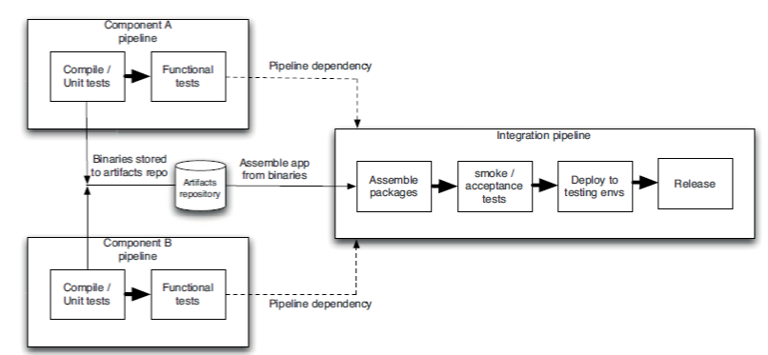
Managing Component
Integration Pipeline

Slide 57
Managing Component
Managing Dependency Graphs
Having set of components, each with their own pipeline, feeding into an integration pipeline which assembles the application and runs automated and manual tests on the ﬁnal application
However, things are often not quite this simple:
Components can have dependencies on other components, including third-party libraries
If you draw a diagram of the dependencies between components, it should be a directed acyclic graph (DAG)
If this is not the case (and in particular, if your graph has cycles) you have a pathological dependency problem

Slide 58
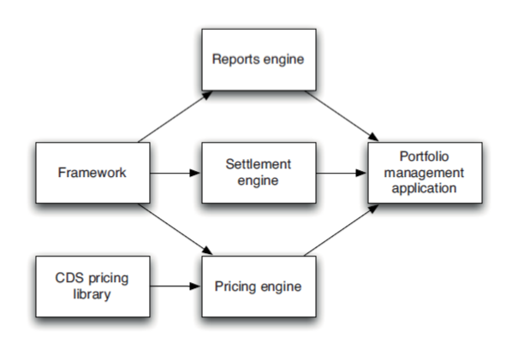
Managing Component
Building Dependency Graphs
credit default swap (CDS) library that is provided by third party

Slide 59
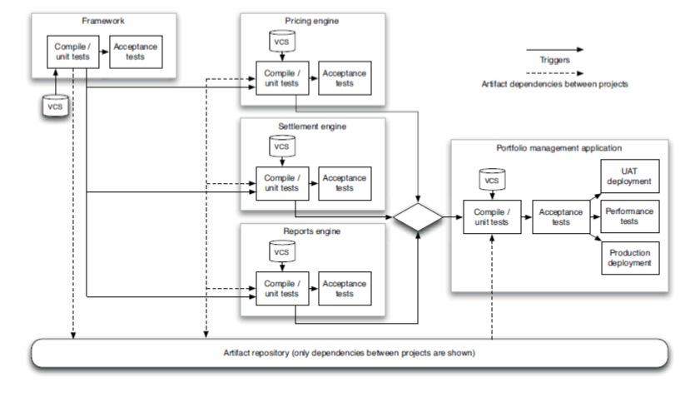
Managing Component
Pipelining Dependency Graphs

Slide 60
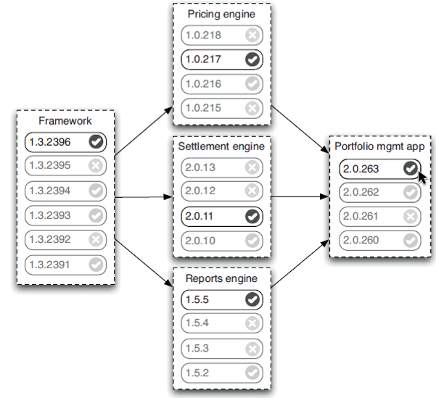
Managing Component
Pipelining Dependency Graphs Contd..
Visualizing upstream dependencies

Slide 61
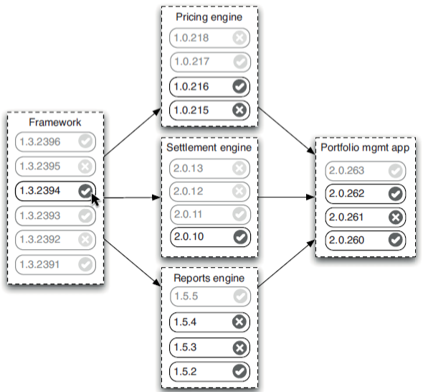
Managing Component
Pipelining Dependency Graphs Contd..
Visualizing downstream dependencies

Slide 62
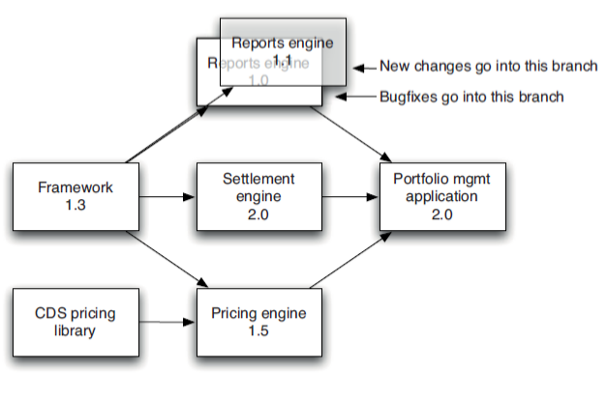
Managing Component
Pipelining Dependency Graphs Contd..
Branching Components

Slide 63
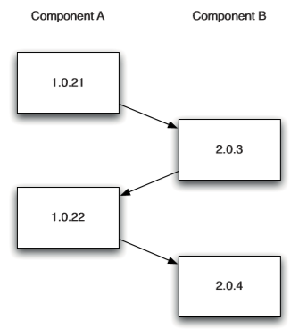
Managing Component
Circular Dependencies
This occurs when the dependency graph contains cycles
The simplest example is that you have a component, A, that depends on another component, B, unfortunately component B in turn depends on component A
to survive this problem so long as there is a version of component A that you can use to build component B then use the new version of B to build the new version of A
This results in a kind of “build ladder”
No build system supports such a conﬁguration out of the box, so you have to hack your toolchain to support it.
also have to be cautious in how the parts of your build interact
Circular dependency build ladder

Slide 64
Thank You!
In our next session:

